Slide 1
The Parts of a Computer
Cheltenham Courseware

Slide 2
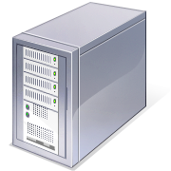
System Unit
The main PC box which houses the various elements which go together to make up the PC.
COntains iteems such as the computer memory, hard disk and DVD drives.

Slide 3
System or Mother board
Contained within your system unit
The CPU is normally housed on your system board
Items such as the hard disk are attached to the system board, either directly or via ables.

Slide 4
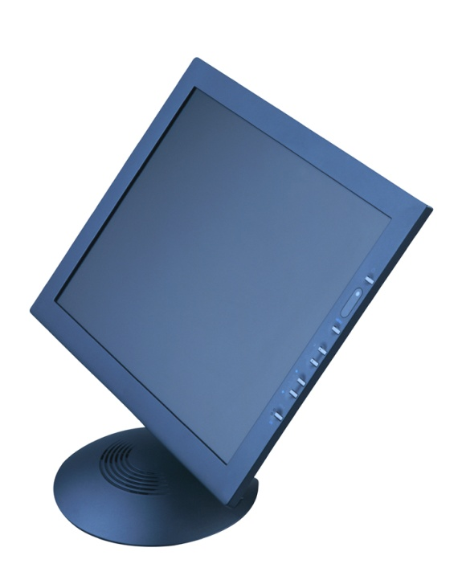
Screen
TV type screen on which you view your programs. They are supplied in different sizes, common sizes range from 15" to 21" screens.
Poor quality or badly maintained monitors can harm your eyesight.

Slide 5
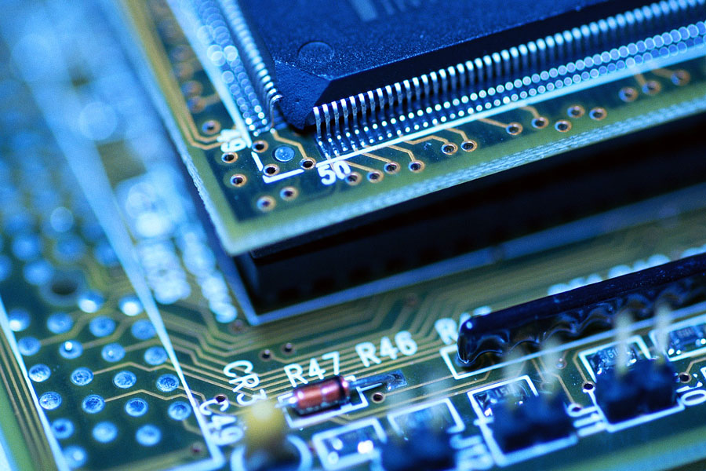
CPU
One of the most important components within your computer
Determines how fast your computer will run and is measured by its GHz speed

Slide 6
Memory (RAM)
RAM (Randoom Access Memory)
Is where the operating system is loaded to when you switch on your computer and also where your applications are copied to when you start an application, such as a word processor or database program.

Slide 7
Keyboard
Allows you to type information into the computer

Slide 8
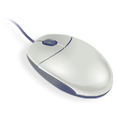
Mouse
Used to select drop down menus, to point and click on items, to select items and to drag and drop items from one place to another

Slide 9
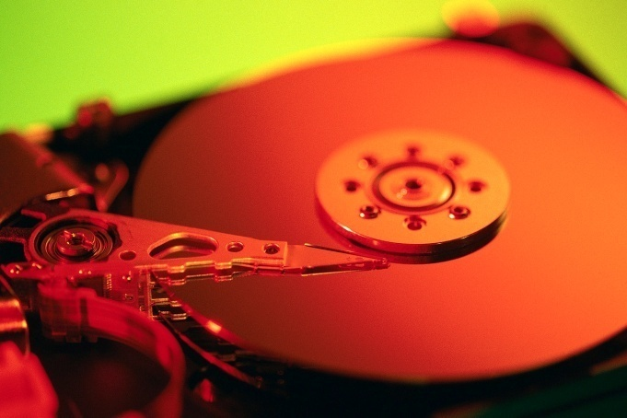
Hard Disk
The main storage area within your computer.
Used to store your operating system, your application programs (i.e. your word processor, games etc) and your data.
Hard disks are installed within the system unit of your computer.

